Slide 1

Sales Oracle
AI Driven Business Sales Forecasting System
Supervisor: Ms. Sawera Kanwal
Presented by:
Muhammad Umair Bilal
Hafiz Mudassir Bilal
Khuzaima Asif
UNIVERSITY OF SOUTH ASIA

Slide 2




Sales Oracle
AI Driven Business Sales Forecasting System
Group Members
Muhammad Umair
Hafiz Mudasir Bilal
Khuzaima Asif
Roll no: B-27430
Roll no: B-27431
Roll no: B-27463
University of South Asia

Slide 3
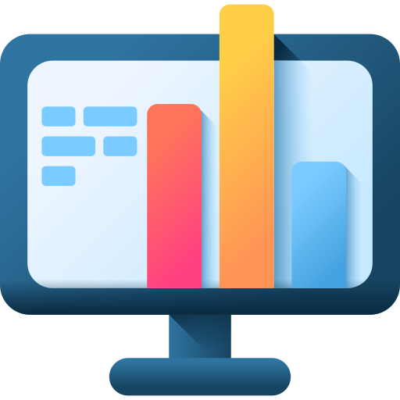
Sales Oracle
AI Driven Business Sales Forecasting System
Introduction
Every retail or departmental store faces one common challenge, knowing what to stock next month. Buying too much leads to waste, and buying too little means lost sales. SalesOracle is built to solve exactly this problem.
SalesOracle is an AI-powered web application that helps sales managers forecast their upcoming month's product sales. By simply uploading past sales data, businesses can instantly see which products are expected to perform well and which are not, allowing smarter and data-driven purchasing decisions.
University of South Asia

Slide 4
Sales Oracle
AI Driven Business Sales Forecasting System
Problem Statement
Manual Guesswork
Outdated Insights
High Cost of Analytics
Sales managers rely on guessing to decide which products to stock, leading to overstocking or running out of fast-selling items.
Most retail stores track sales through basic spreadsheets with no analytical capability, causing trends to be noticed too late.
Professional forecasting tools are expensive and require technical expertise, making them unaffordable for small retail businesses.
University of South Asia

Slide 5

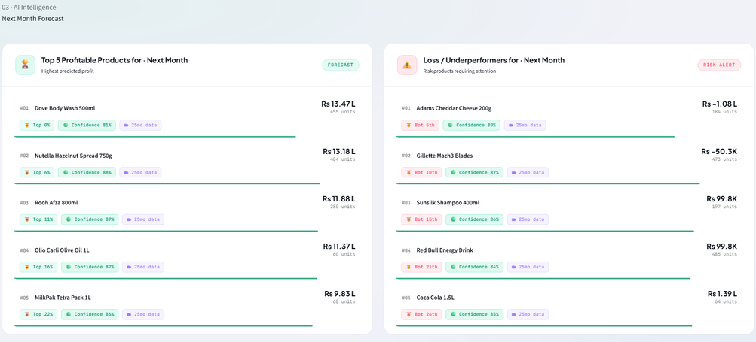
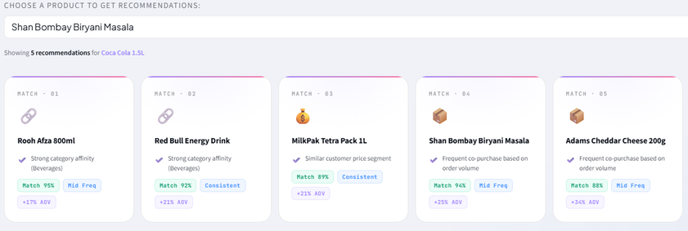
Sales Oracle
AI Driven Business Sales Forecasting System
Proposed Solution
SalesOracle is an AI-driven web application designed for retail and departmental stores to replace manual forecasting with smart, data-driven decisions.
Automated Forecasting: Predicts next month's top and least selling products using the XGBoost model.
Business Overview: Delivers a complete summary of revenue, profit, and units sold instantly.
Product Recommendations: Suggests related products to support better stocking decisions.
Data Intelligence: Presents easy to understand graphs and analytics from uploaded sales data.
Showing Top 5 Products Forecasting and Recommendations
University of South Asia

Slide 6

Sales Oracle
AI Driven Business Sales Forecasting System
Project Scope
Scope Area
Description
Target Users
Sales managers and store owners of retail and departmental stores.
Data Input
CSV files containing product, sales, quantity, revenue, and profit records.
Forecasting
Predicts top 5 most and least selling products for the upcoming month.
Analytics
Business overview, recommendations, and visual data intelligence.
Platform
Fully web-based, accessible through any browser without installation.
University of South Asia

Slide 7

Sales Oracle
AI Driven Business Sales Forecasting System
Comparative Analysis
Feature
Spreadsheets
Tableau
Power BI
SalesOracle
AI Forecasting
✗
✗
Limited
✓
Easy to Use
✓
✗
Limited
✓
Affordable
✓
✗
✗
✓
Product Recommendations
✗
✗
✗
✓
Next Month Forecasting
✗
✗
✗
✓
University of South Asia

Slide 8

Sales Oracle
AI Driven Business Sales Forecasting System
Functional & Non-functional requirements
Functional requirements
Non-functional requirements
CSV file upload for sales data
Business overview display
Next month sales forecasting
Product recommendations
Instant results after upload
Simple and easy to use interface
Accurate XGBoost based forecasting
Fully web-based and accessible
University of South Asia

Slide 9
Sales Oracle
AI Driven Business Sales Forecasting System
System Architecture
Data Layer
Automating data preprocessing and feature engineering to prepare features.
Application Layer
Python
Scikit-Learn
XGBoost
01
02
03
04
Data
Import
Feature Engineering
Model Forecasting
Output Results
Presentation Layer
Streamlit - Rapid, Python-based framework powering the interactive web application and user dashboard.
University of South Asia

Slide 10
Sales Oracle
AI Driven Business Sales Forecasting System
Machine Learning Pipeline
Data Collection
01
Collected 50,000+ rows of sales data.
Preprocessing
02
Null values cleaning, duplicate removals.
Best Performing model is XGBOOST with
91%
Feature Engineering
03
5+ engineered features like lag_qty, lag_profit and month.
04
Model Training
Applied XGBoost Regressor machine learning algorithm.
University of South Asia

Slide 11
Sales Oracle
AI Driven Business Sales Forecasting System
Security & Privacy
Data Privacy
Safe Processing
Business Protection
Your uploaded sales records are kept completely secure and are never shared with outside parties.
The AI analyzes your data securely in the background without permanently storing or exposing your sensitive files.
It ensures that your private business metrics—like profit margins and top losing products—stay strictly between you and the dashboard.
University of South Asia

Slide 12
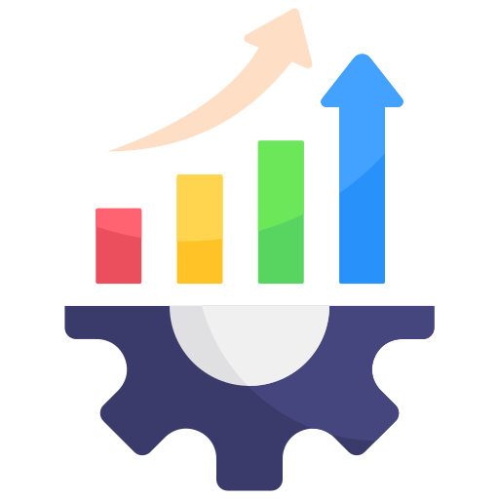
Sales Oracle
AI Driven Business Sales Forecasting System
System Benefits
SalesOracle empowers retail businesses to make smarter, faster, and more profitable decisions. It replaces manual guesswork with AI driven insights that are easy to understand and act upon.
Smarter Stock Decisions: Buy right products in right quantity, reducing waste and shortages.
Saves Time: Instant results eliminate hours of manual data analysis.
Cost Effective: No expensive tools or technical staff required.
Increased Profitability: Right stocking maximizes sales and reduces unnecessary expenses.
University of South Asia

Slide 13

Sales Oracle
AI Driven Business Sales Forecasting System
Future Improvements
SalesOracle is built with scalability and long term growth in mind. While the current version successfully addresses core forecasting and analytics needs, the following enhancements are planned to make the system even more powerful, automated, and accessible for businesses in the future.
Mobile Application: Access forecasts and insights anytime from a dedicated mobile app.
SMS & WhatsApp Alerts: Get instant notifications about low stock or high demand products.
Automated Goal Tracking: Set sales targets and let the system track and report progress automatically.
University of South Asia

Slide 14
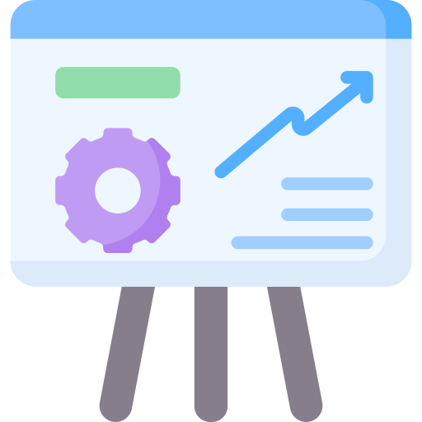
Sales Oracle
AI Driven Business Sales Forecasting System
Conclusion
SalesOracle successfully addresses the challenge of predicting future product sales for retail and departmental stores. It empowers sales managers to make smarter stocking decisions without any technical expertise or expensive tools.
By uploading a simple CSV file, businesses instantly get sales forecasts, business overview, product recommendations, and data analytics, all powered by the XGBoost machine learning model, making SalesOracle a practical and affordable solution for the retail industry.
University of South Asia

Slide 15

Sales Oracle
AI Driven Business Sales Forecasting System
Thank you!
University of South Asia

